Slide 1
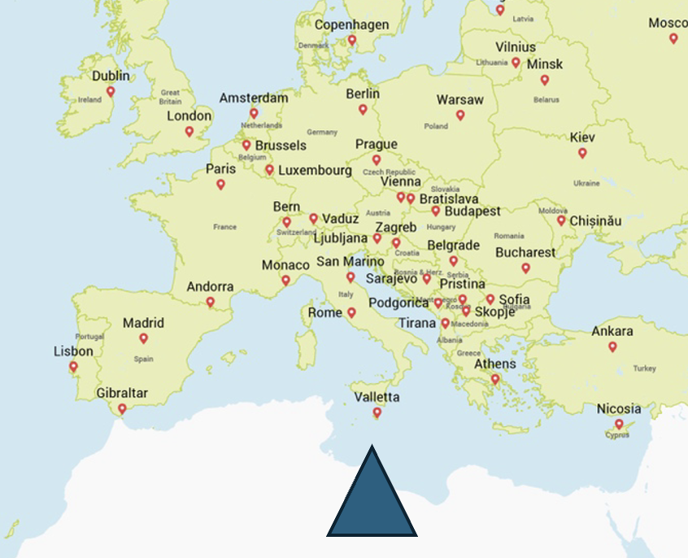
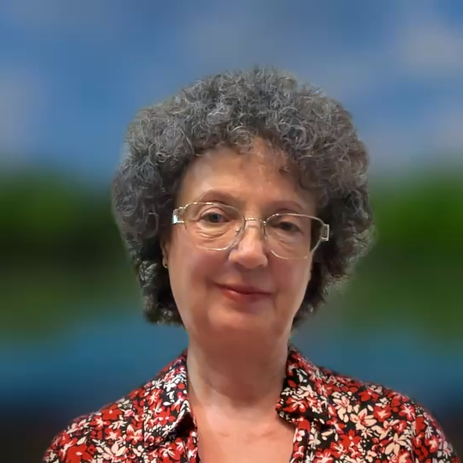
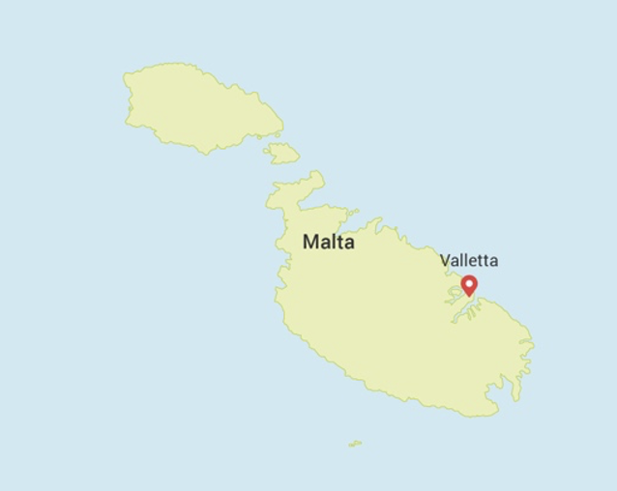
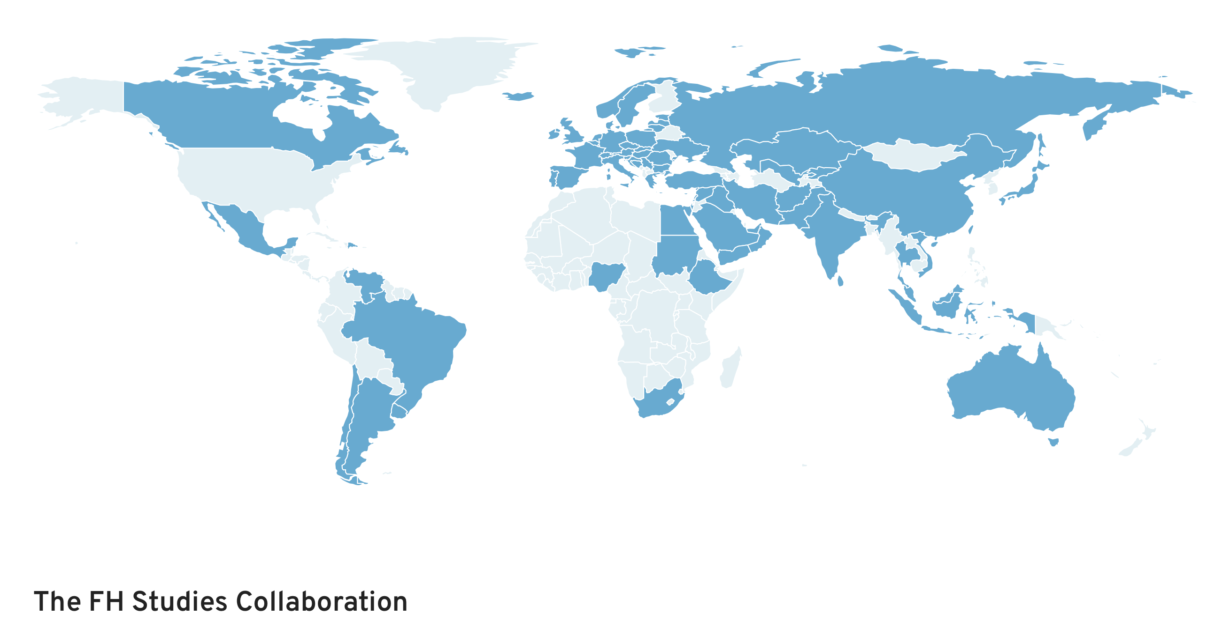
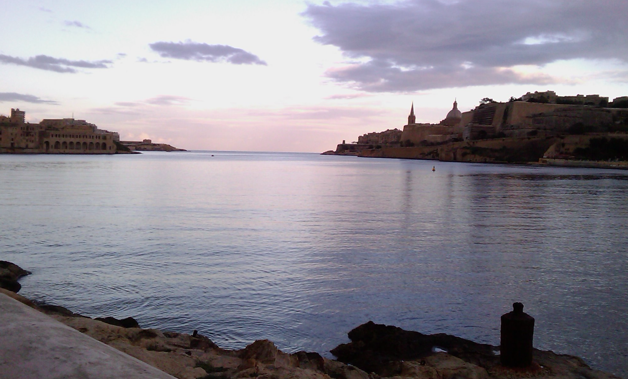
Why participate in FHSC?
Myra Tilney
MD FRCP FRCP(Edin) FACP FEFIM MBA(Henley)
FH Register
Malta
Notes:
Hello I'm Myra Tilney, located at he southernmost tip of Europe, in Malta which has a population of just over half a million. Collaboration with the FHSC has helped to improve both identification of the condition and the care of our pts in a unique network.

Slide 2

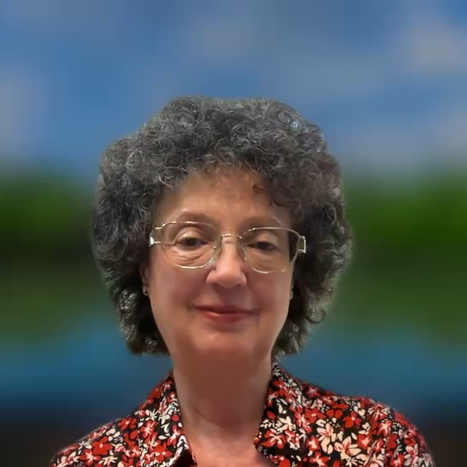
How has being part of FHSC helped raise awareness and improve care for FH in your country/region?
-better identification and care of our patients. Overall
Participating in a global community focused on this condition aiming at excellence through real world experience-and learning.
-Raised awareness for patients and healthcare professionals
-Started FH Register permitting a global overview-retrospective and longitudinal
-Since started genetic identification has been introduced, and ongoing care is reviewed
-identifying differences in care between men and women
Targeting optimal management and health outcomes

Slide 3

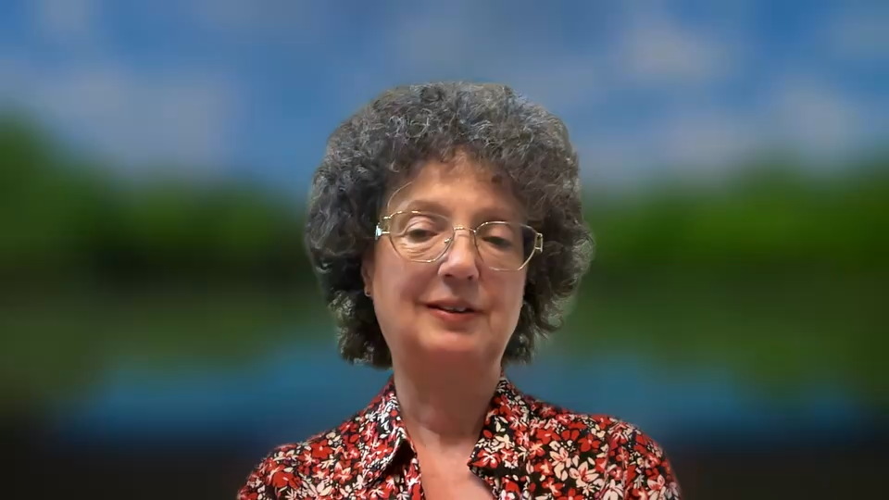
What FHSC research milestone do you find most important — and why?
The most important aspect for patients is that they are identified early-so I am interested in how this is taking place
-and how it could be improved to maximise coverage.
How can current identification methods be improved?
Can novel tools facilitate earlier diagnosis?
Understanding how care affects longitudinal health outcomes
Notes:
The most important aspect for patients is early identification-so I'm interested in how this could be improved to maximise coverage and health outcomes.
I'm investigating how digital tools could facilitate earlier diagnosis, especially to understand how this could be applied to cascade testing in our healthcare context.

Slide 4
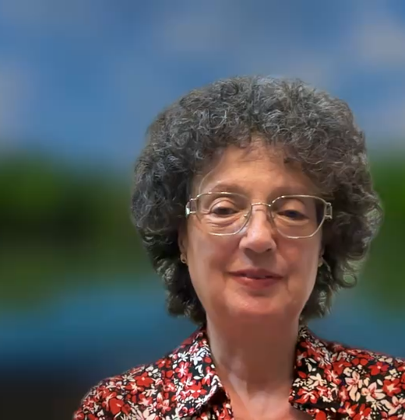
What message would you like to send to the global community during FH Awareness Week?
Participate!
-Unique global collaboration
-Generating an evidence-base from real-world practice
- Targeting excellence
Notes:
Finally, in answer to this question ….My message is that this collaboration is IMP for pts AND HCP-It's leading to new knowledge and helping to provide evidence which based on real-world practice targeting excellence.
Thank you for listening-and please PARTICIPATE if you can!

